Slide 1
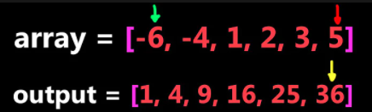
Sorted SquaredArray

Slide 2
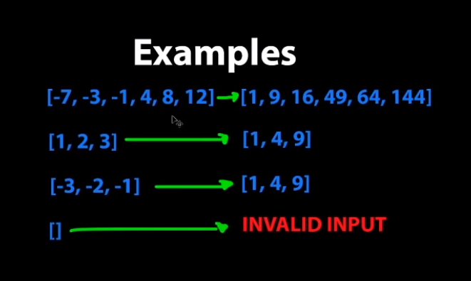
Sorted SquaredArray

Slide 3
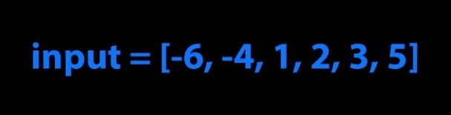
Sorted SquaredArray

Slide 4
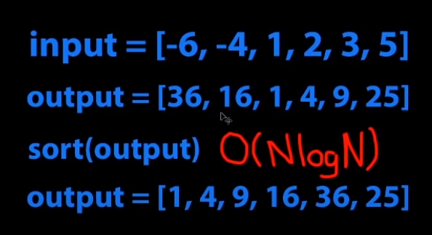
Solution 1

Slide 5
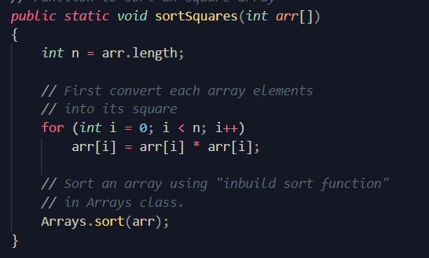

Slide 6
Solution 2
Initialize left=0 and right=n-1
if abs(left) >= abs(right) then store
square(arr[left])
at the end of result array and increment left pointer
else store square(arr[right]) in the result array and decrement right pointer
decrement index of result array

Slide 7
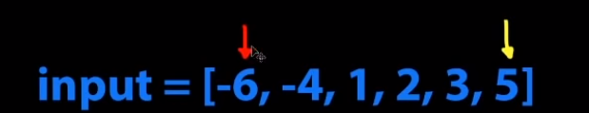
Solution 2

Slide 8
